Slide 1

Science Rocks in English, too!
Edita Matkić
Sabina Skenderović Bukvić

Slide 2
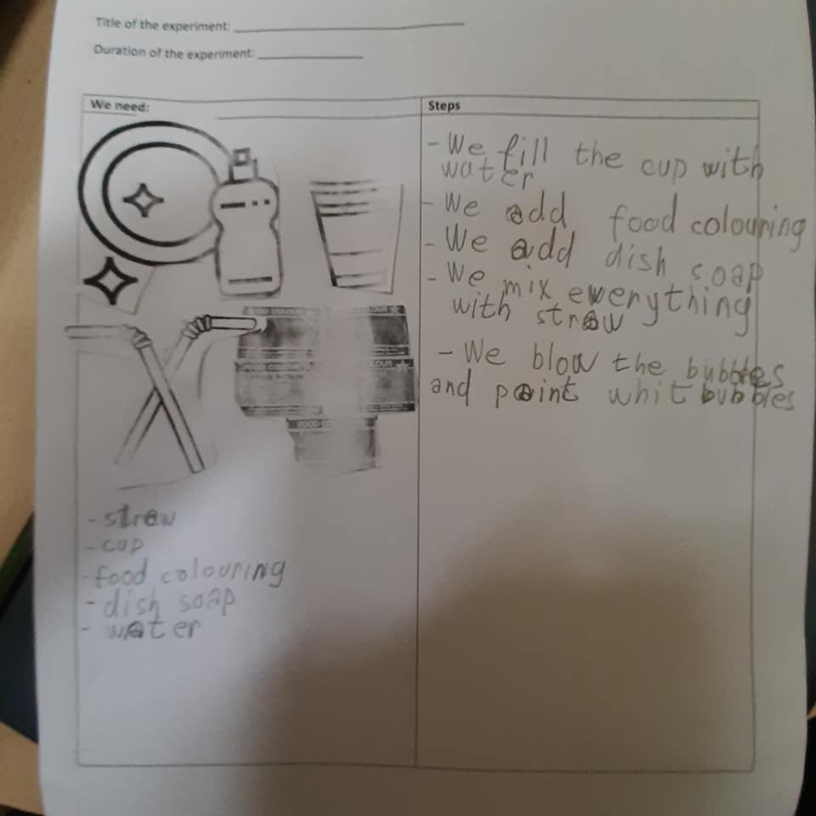
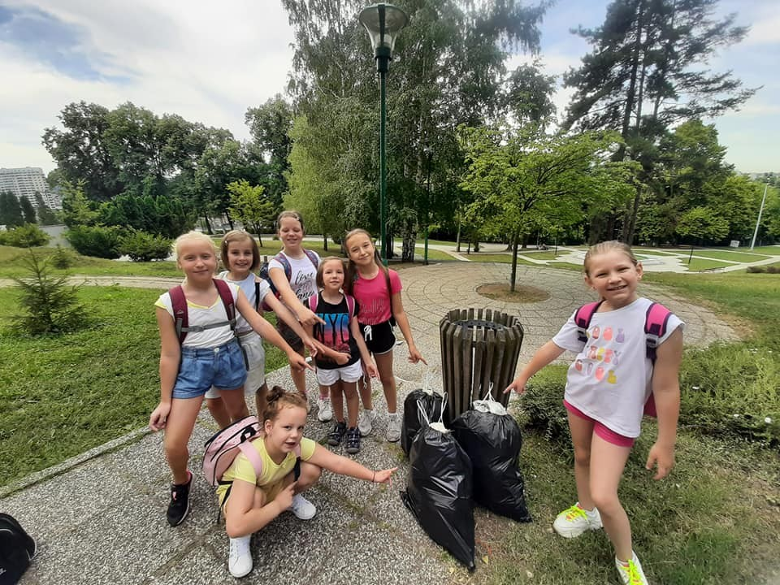
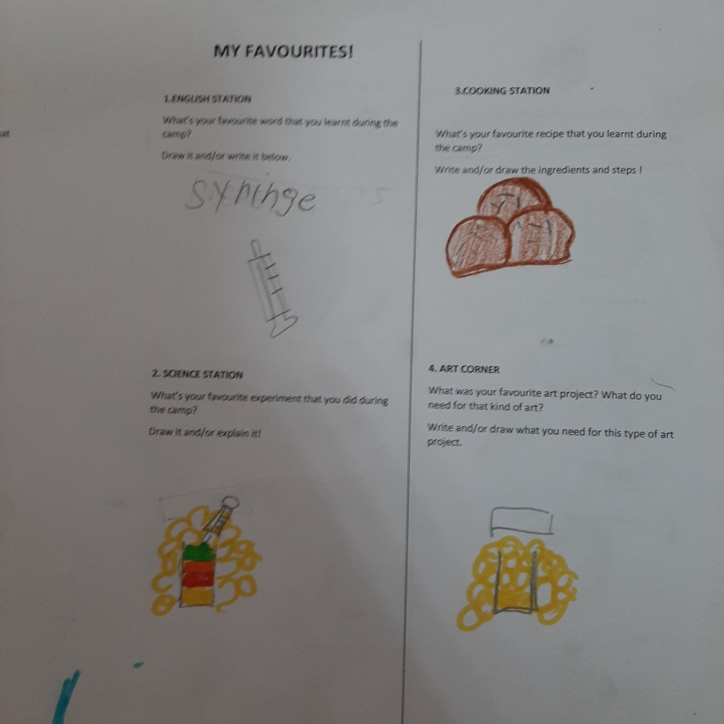
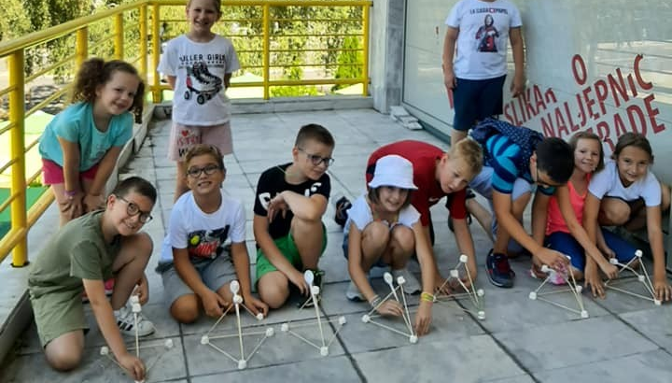

Slide 3
OUTLINE
3 experiments
Possible applications/variations
Additional hard-copy and digital materials

Slide 4
Target students
AGE 6- 8
Age 9 – 11
Age 12 – 13
focus on:
vocabulary;
Speaking: fluency
getting students to like science
focus on
Speaking: fluency + accuracy
FUNCTIONAL LANGUAGE: describing a process
Using linkers
Grammar: countable and uncountable nouns
focus on :
functional language, writing
MAKING CONCLUSIONS,
CONNECTING SCIENTFIC LAWS TO ENGLISH
IDIOMATIC EXPRESSIONS

Slide 5
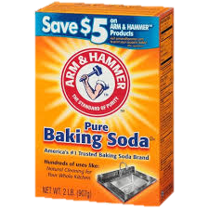
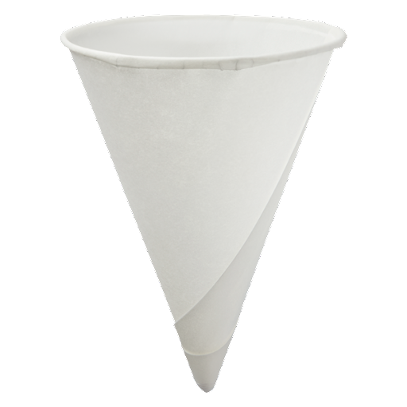

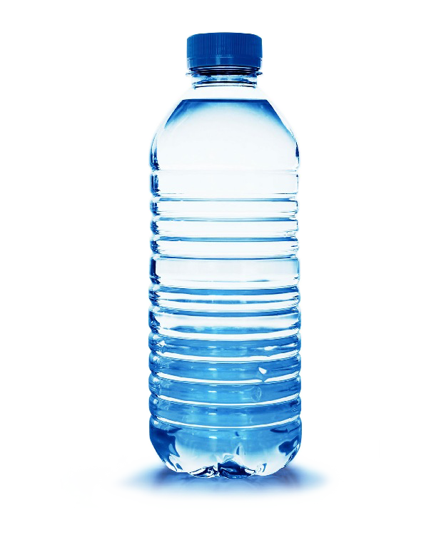
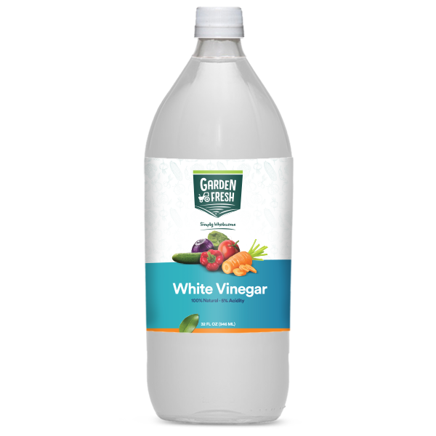
Experiment 1: Self-inflating balloon
We need:
Baking soda
A plastic bottle
Vinegar
A balloon
A paper funnel

Slide 6
PROCESS
Make a paper funnel
Add baking soda into the ballon using the funnel
Pour some vinegar into the bottle
Place the balloon over the mouth of the bottle
Pour the soda from the balloon into the bottle with vinegar
WOW!

Slide 7
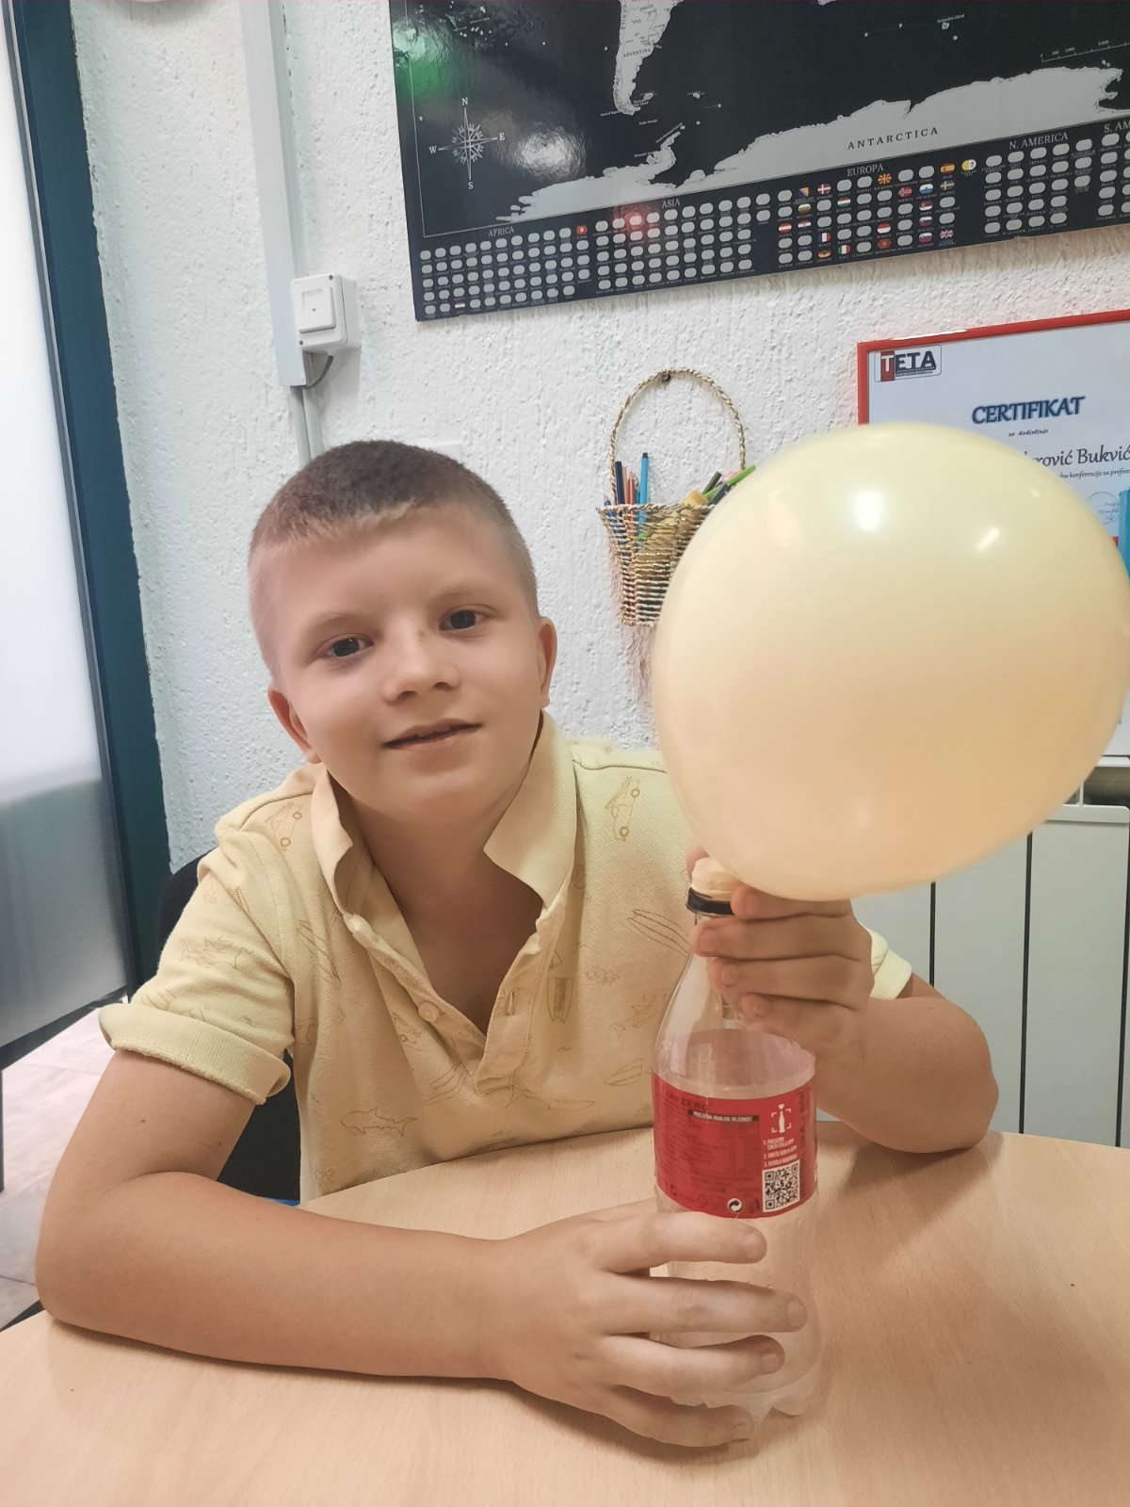
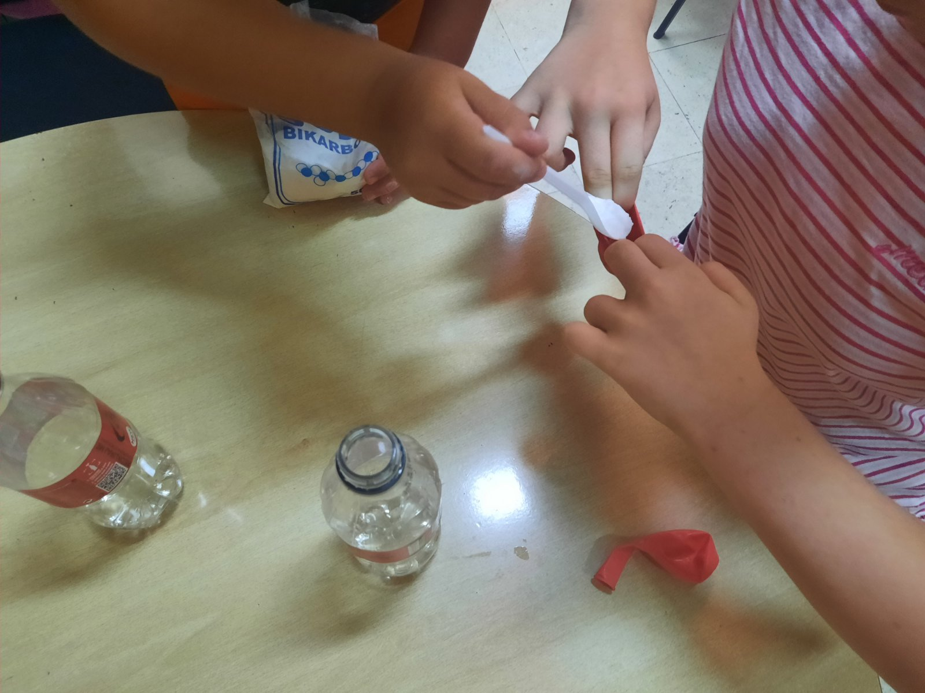
Experiment 1: Self-inflating balloon

Slide 8
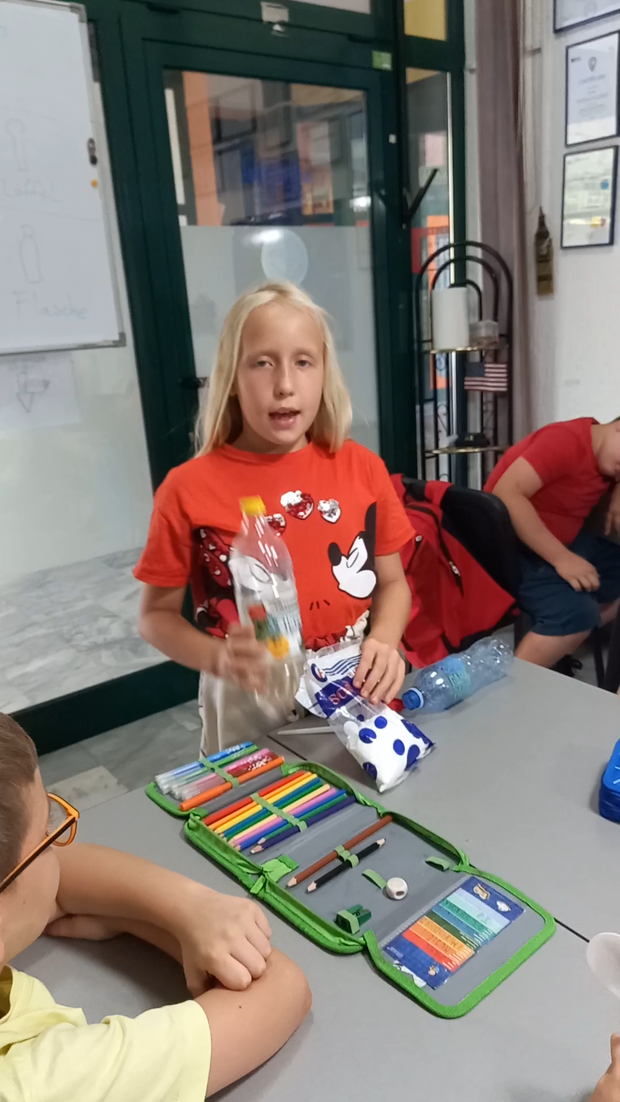
Self-inflating balloon

Slide 9
Kahoot!
Let's play!

Slide 10
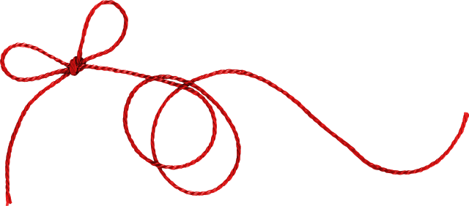
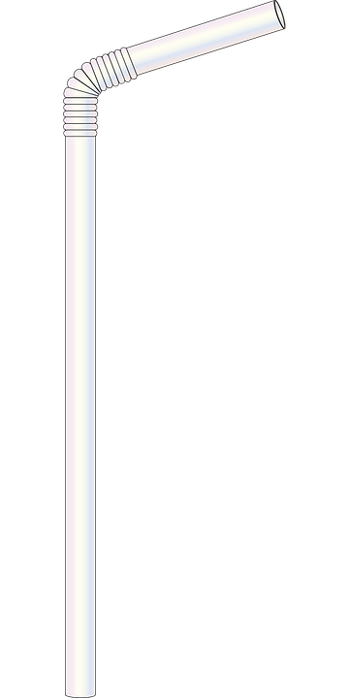
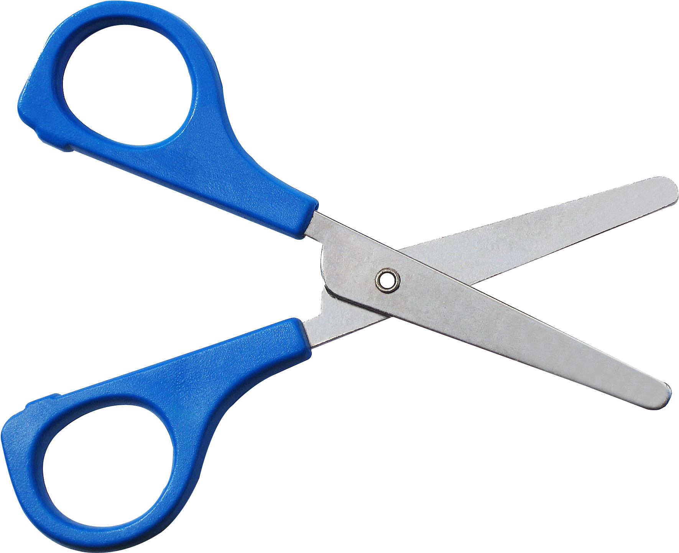
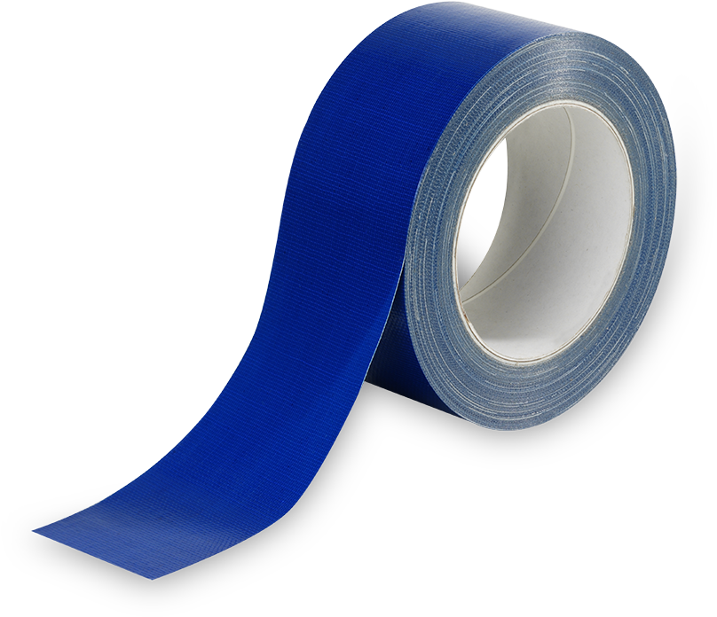
Experiment 2: Balloon rocket
For this experiment, you need:
A balloon
A string
A straw
Scissors
A Tape

Slide 11
PROCESS
First, take the string and tie one end on a chair or table.
Then cut a small piece of straw.
Then put this straw at the end of balloon and tie it with tape.
Cut another piece of straw and stick it on the back of balloon using tape.
Then tie the string on another chair/table.
Finally, blow air inside balloon and launch your rocket!

Slide 12
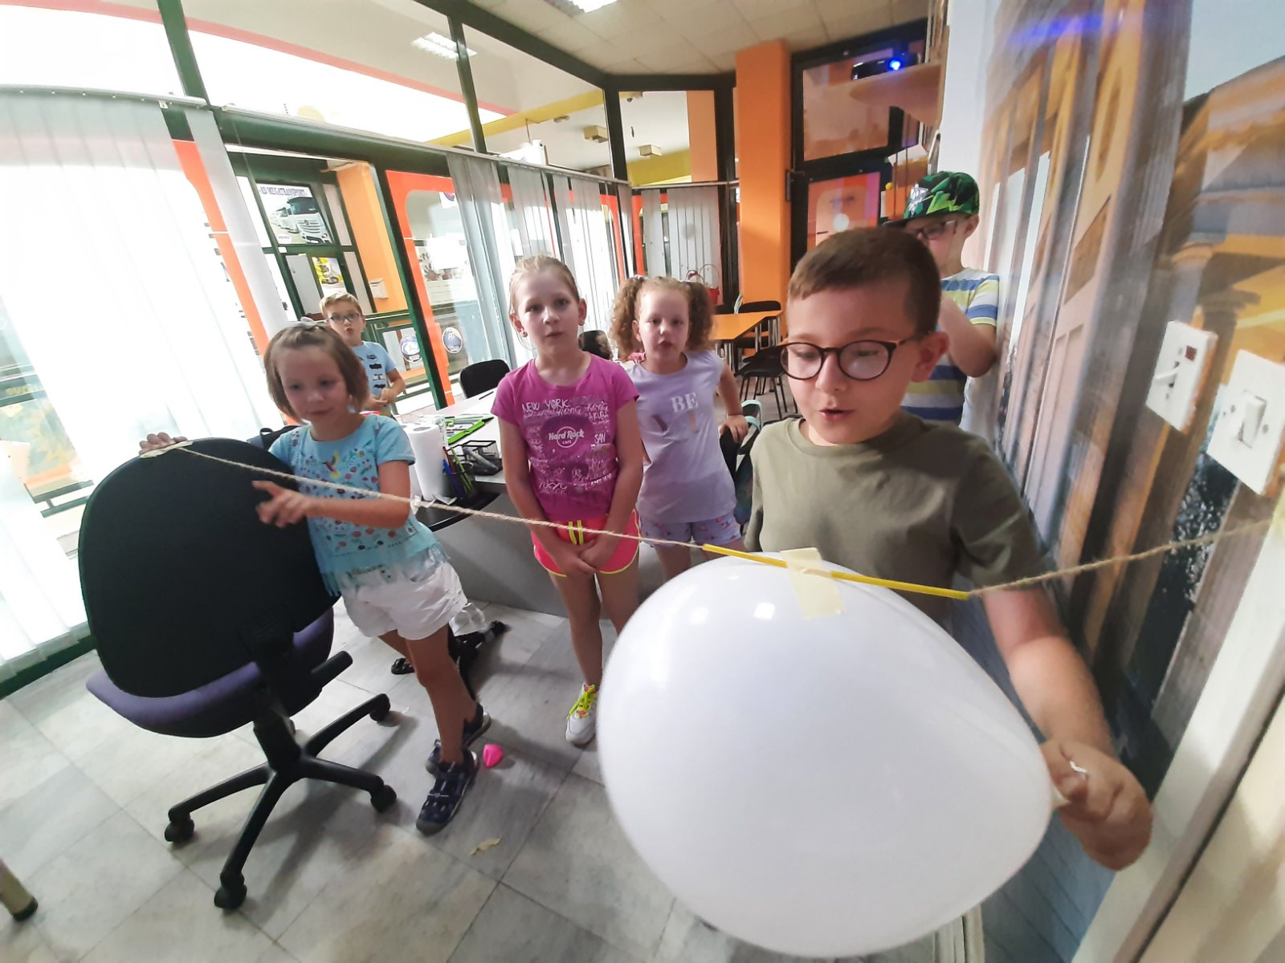
Balloon rocket

Slide 13
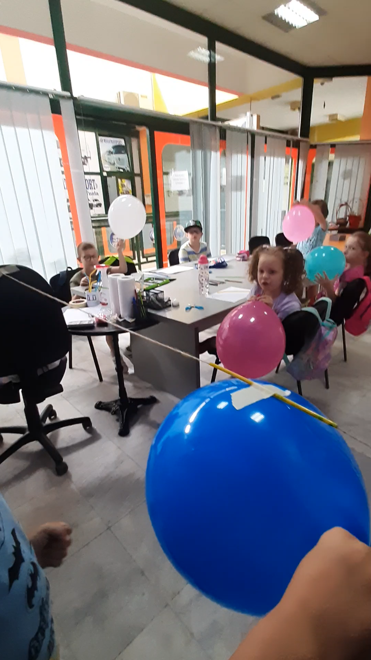
Balloon rocket

Slide 14
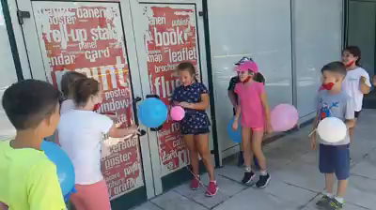
Balloon rocket race

Slide 15
Think!
1. Does the shape of the balloon affect how far (or fast) the rocket travels?
2. Does the length of the straw affect how far (or fast) the rocket travels?
3. Does the type of string affect how far (or fast) the rocket travels? (try fishing line, nylon string, cotton string, etc.)
4. Does the angle of the string affect how far (or fast) the rocket travels?

Slide 16
QUIZLET: YOUNG LEARNERS
FLASHCARDS - Pierce the balloon
TEST - Pierce the balloon

Slide 17

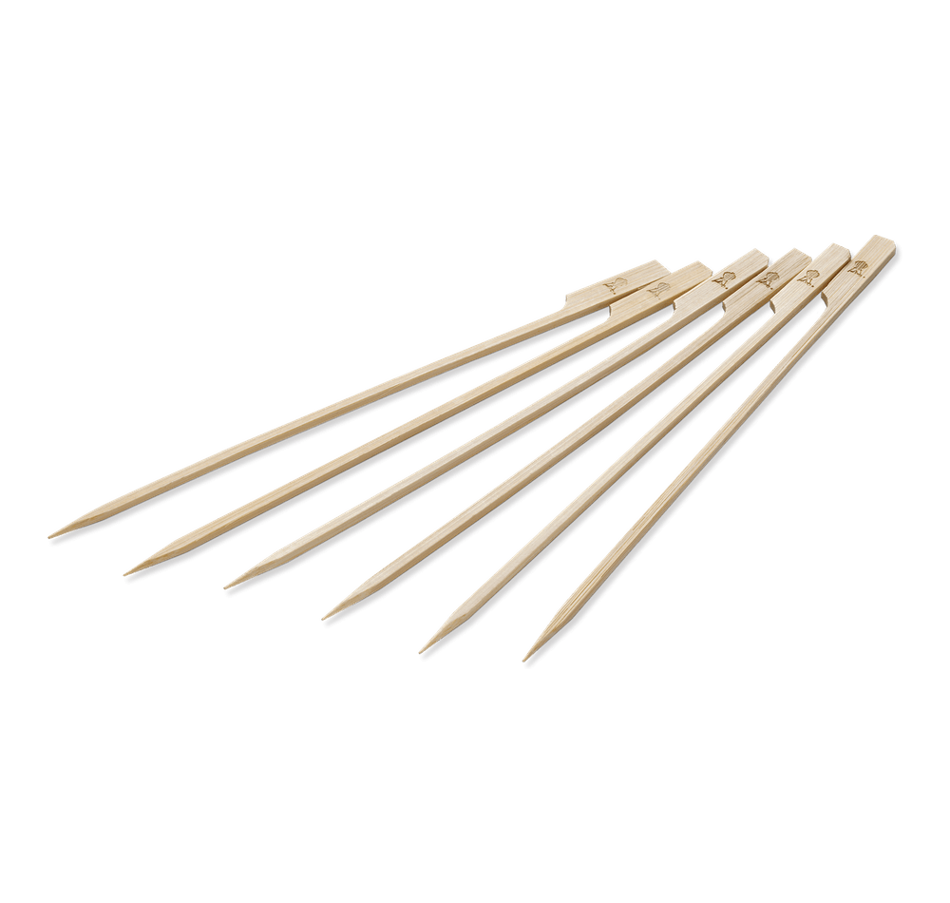
Experiment 3: Pierce the balloon
We need:
A skewer
A balloon
A LOT OF PATIENCE

Slide 18
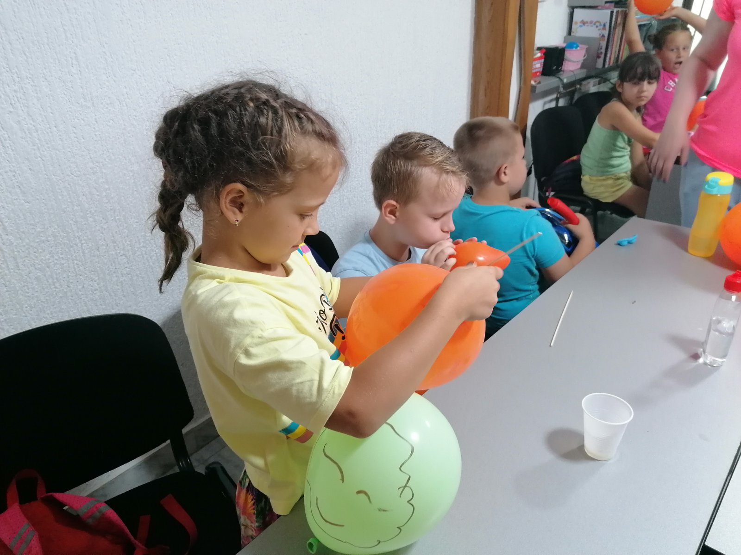
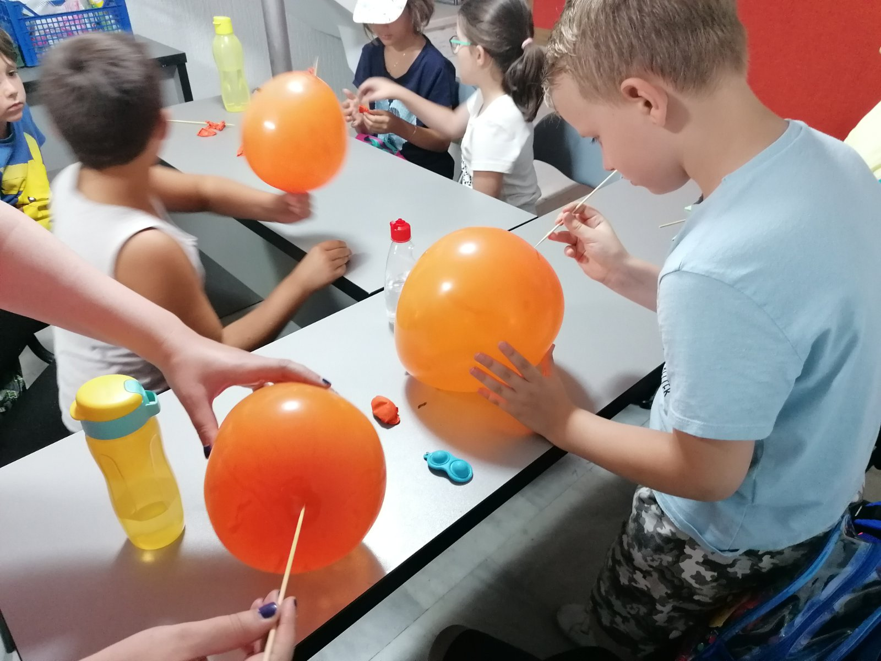
Pierce the balloon

Slide 19
Thank you for your attention ! ☺
bigbentuzla@gmail.com

Slide 20
Sources of the pictures: www. freepic.com

